Slide 1
Corporate Governance
CHAPTER 13
© 2020 Cengage Learning. All Rights Reserved. May not be copied, scanned, or duplicated, in whole or in part, except for use as permitted in a license distributed with a certain product or service or otherwise on a password-protected website for classroom use.

Slide 2
Topics in Chapter
Agency Conflicts
Corporate Governance

Slide 3
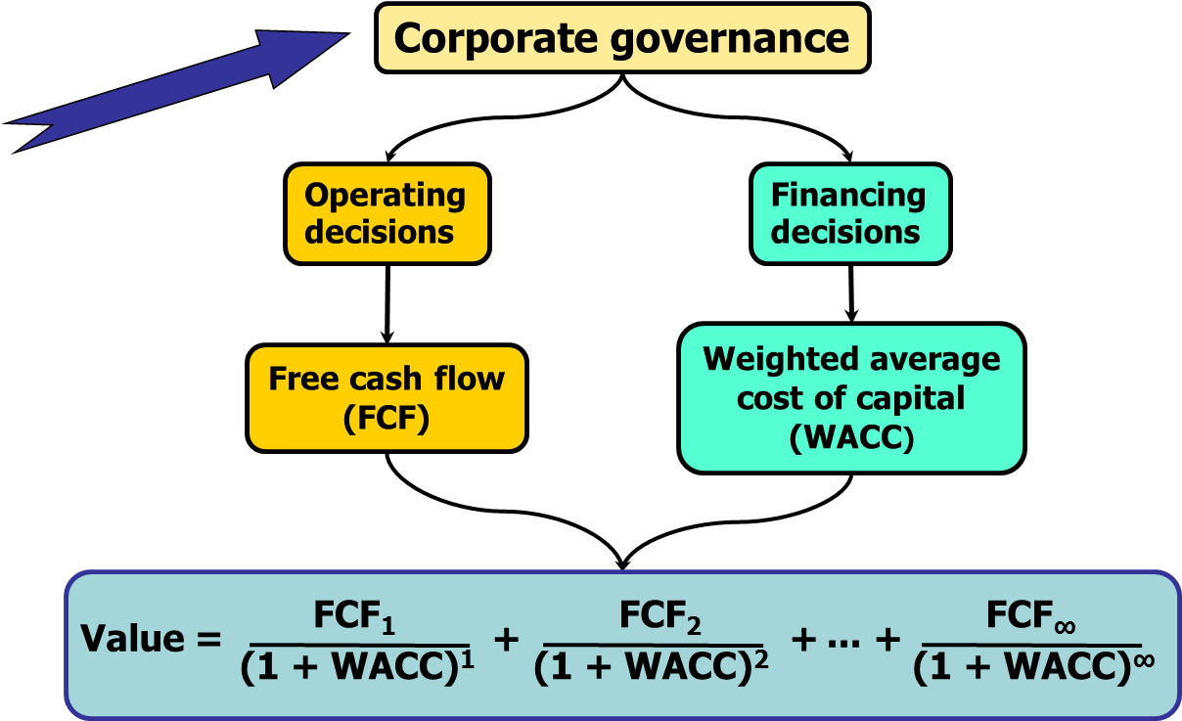
Corporate Governance and Corporate Value

Slide 4
What is an agency relationship?
An agency relationship arises whenever one or more individuals, called principals, (1) hires another individual or organization, called an agent, to perform some service and (2) then delegates decision-making authority to that agent.

Slide 5
If you are the only employee, and only your money is invested in the business, would any agency problems exist?
No agency problem would exist. A potential agency problem arises whenever the manager of a firm owns less than 100 percent of the firm’s common stock, or the firm borrows. You own 100 percent of the firm.

Slide 6
Would hiring additional people create agency problems?
An agency relationship could exist between you and your employees if you, the principal, hired the employees to perform some service and delegated some decision-making authority to them.

Slide 7
Owner/managers versus Outside Shareholders
Benefits of being an owner/manager:
Increase wealth due to owning company
Perquisites (perks):
Luxurious offices
Executive assistants
Expense accounts
Limousines and auto allowances
Country club memberships
Generous retirement plan

Slide 8
Who bears the costs of the perks?
If the owner/manager owns all the stock, the owner/manager bears all costs.
If there are also outside shareholders, they bear some of the cost due to the owner/manager’s perks.
Therefore, minority shareholders will pay less for shares of stock—this is an agency cost.

Slide 9
Borrowers versus Lenders
After the loan is originated, borrowers can make decisions that affect the lender:
Invest in risky projects.
Who benefits most if there is a small payoff, medium payoff, or big payoff?
Who loses most if there is a small loss, medium loss, or big loss?
Take on additional debt

Slide 10
Agency Cost of Debt
Creditors anticipate possible harmful actions by stockholders
Creditors charge higher interest rate.
Company’s cost of capital goes up.
Value of company goes down.
This is an agency cost.

Slide 11
What actions reduce agency cost of debt?
Securing the loan with company’s assets.
Placing restrictive covenants in debt agreements. The borrower must:
Maintain profitability ratios and retained earnings at a certain level before making any distributions to shareholders.
Maintain debt ratios at specified levels.
Not issue more debt.

Slide 12
The Modern Corporation
Many shareholders, none who own a controlling interest in the company.
Decision-making delegated by shareholders to an elected board of directors.
Board delegates most decision-making to hired executives, who then hire other employees and delegate some decision-making.
Potential agency conflict between shareholders and managers.

Slide 13
Six Potential Problems with Managerial Behavior (1 of 2)
Expend too little time and effort.
Consume too many nonpecuniary benefits.
Avoid difficult decisions (e.g., close plant) out of loyalty to friends in company.

Slide 14
Six Problems with Managerial Behavior (2 of 2)
Reject risky positive NPV projects to avoid looking bad if project fails; take on risky negative NPV projects to try and hit a home run.
Avoid returning capital to investors by making excess investments in marketable securities or by paying too much for acquisitions.
Massage information releases or manage earnings to avoid revealing bad news.

Slide 15
Corporate Governance
The set of laws, rules, and procedures that influence a company’s operations and the decisions made by its managers.
Sticks (threat of removal)
Carrots (compensation)

Slide 16
Corporate Governance Provisions Under a Firm’s Control
Board of directors
Charter provisions affecting takeovers
Compensation plans
Capital structure choices
Internal accounting control systems

Slide 17
Effective Boards of Directors (1 of 4)
Election mechanisms make it easier for minority shareholders to gain seats:
Not a “classified” board (i.e., all board members elected each year, not just those with multi-year staggered terms)
Board elections allow cumulative voting

Slide 18
Effective Boards of Directors (2 of 4)
CEO is not chairman of the board and does not have undue influence over the nominating committee.
Board has a majority of outside directors (i.e., those who do not have another position in the company) with business expertise.

Slide 19
Effective Boards of Directors (3 of 4)
Is not an interlocking board (CEO of company A sits on board of company B, CEO of B sits on board of A).
Board members are not unduly busy (i.e., set on too many other boards or have too many other business activities)

Slide 20
Effective Boards of Directors (4 of 4)
Compensation for board directors is appropriate
Not so high that it encourages cronyism with CEO
Not all compensation is fixed salary (i.e., some compensation is linked to firm performance or stock performance)

Slide 21
Anti-Takeover Provisions
Targeted share repurchases (i.e., greenmail)
Shareholder rights provisions (i.e., poison pills)
Restricted voting rights plans

Slide 22
Stock Options in Compensation Plans (1 of 2)
Gives owner of option the right to buy a share of the company’s stock at a specified price (called the strike price or exercise price) even if the actual stock price is higher.
Usually can’t exercise the option for several years (called the vesting period).

Slide 23
Stock Options in Compensation Plans (2 of 2)
Can’t exercise the option after a certain number of years (called the expiration, or maturity, date).

Slide 24
Problems with Stock Options
Manager can underperform market or peer group, yet still reap rewards from options as long as the stock price increases to above the exercise cost.
Options sometimes encourage managers to falsify financial statements or take excessive risks.

Slide 25
Block Ownership
Outside investor owns large amount (i.e., block) of company’s shares
Institutional investors, such as CalPERS or TIAA-CREF
Blockholders often monitor managers and take active role, leading to better corporate governance

Slide 26
Regulatory Systems and Laws
Companies in countries with strong protection for investors tend to have:
Better access to financial markets
A lower cost of equity
Increased market liquidity
Less noise in stock prices

